Slide 1



Dip in 7 Lesson 14 Association game

Slide 2


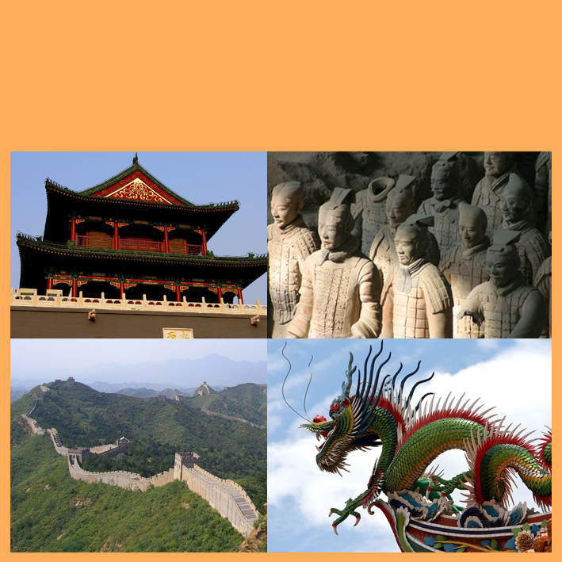


A1
coffee
B1
milk
C1
a country
D1
a plant
hair
cream
East Asia
A2
B2
C2
D2
long and green
coal
snow
the Great Wall
fast-growing
A3
B3
C3
D3
A4
raven
B4
paper
C4
the Yangtze River
used in construction
D4
COLUMN A
COLUMN C
BLACK
COLUMN B
CHINA
WHITE
BAMBOO
COLUMN D
THE FINAL ANSWER
PANDA

